Slide 1
TRAFFIC ACCIDENT SEVERITY PREDICTION
Predicting the traffic accident severity using Machine Learning Algorithms
Applied Data Science Capstone by IBM/Coursera

Slide 2
Predicting traffic accident severity
More than 3700 people lose their lives everyday in road accidents
Weather conditions, Road conditions and Light conditions are enough to predict an accident severity by their own? Which variable affect the algorithm the most?
Predicting the accident severity could help each driver, telling them when to pay more attention or slow down in case of adverse conditions

Slide 3
Data acquisition and cleaning
The Seattle Collisions Dataset (2003-2020), available here
The Seattle Collisions Dataset Metadata, available here
Png Image of Seattle City that I especially made for this project, available here
221738 row in total and 40 columns
Missing data will be dropped/replaced
After cleaning and transformed categorical columns into numerical columns: 194827 rows and 41 columns (1st analysis); 194827 rows and 29 columns (2nd analysis)

Slide 4
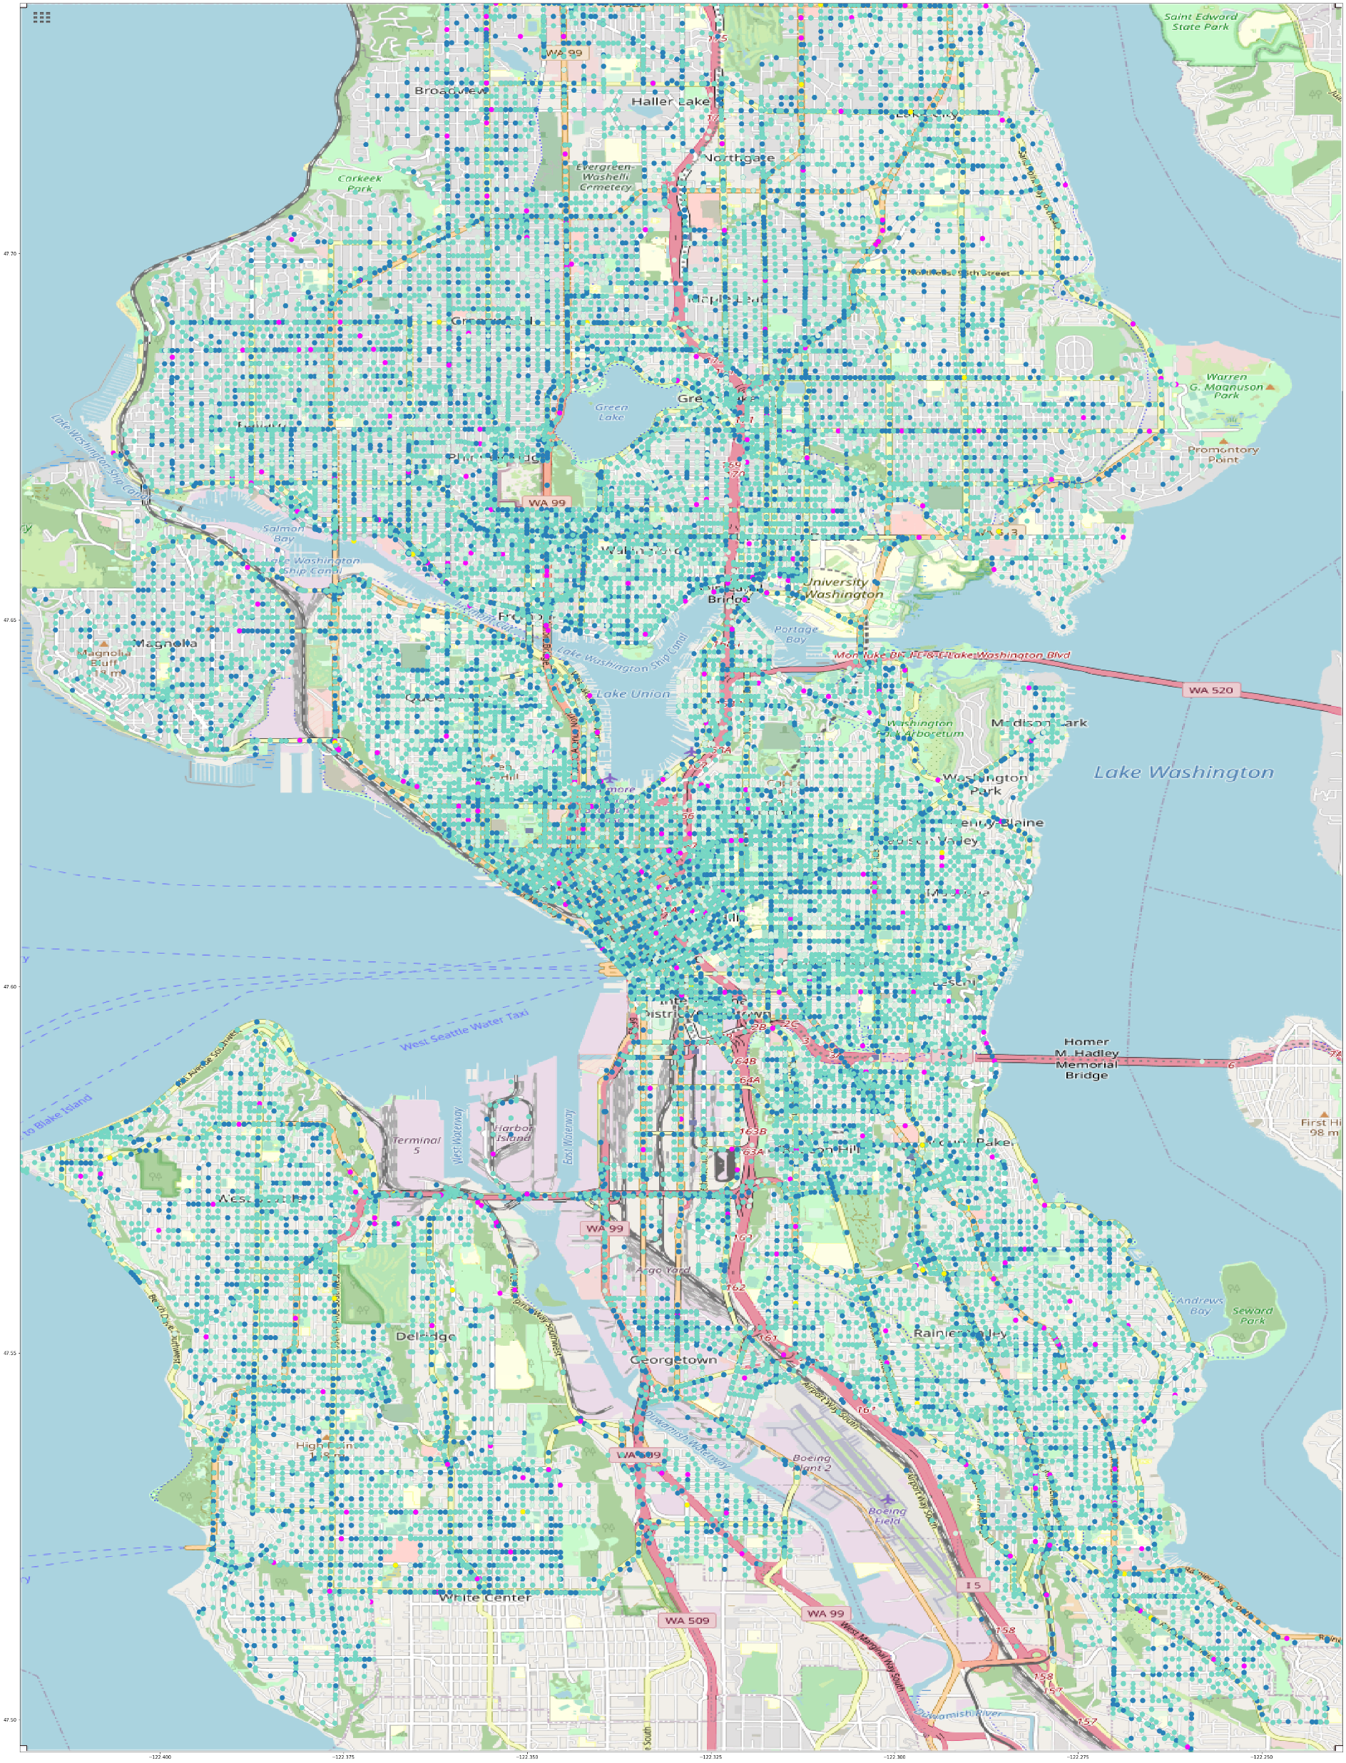
Even if not in the scope of this project, the accidents map shows a concentration in the city-center and in the north of Seattle
Further analysis are required to establish a certain correlation with locations and density of population/business locations with the accidents

Slide 5
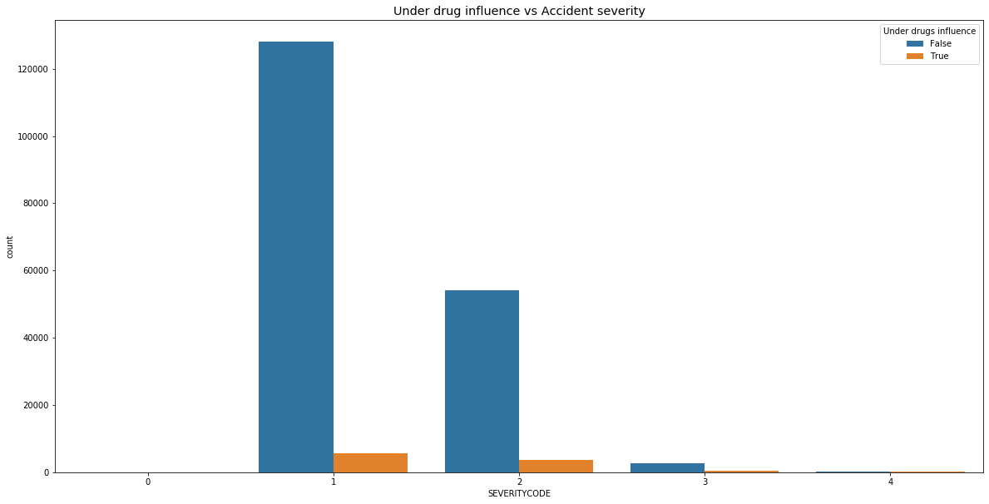
Under drug influence
Under the use of drugs, the probability to incur in a serious accident ( severity = 4) is ~ 1% against 0.1% of not being under drugs

Slide 6
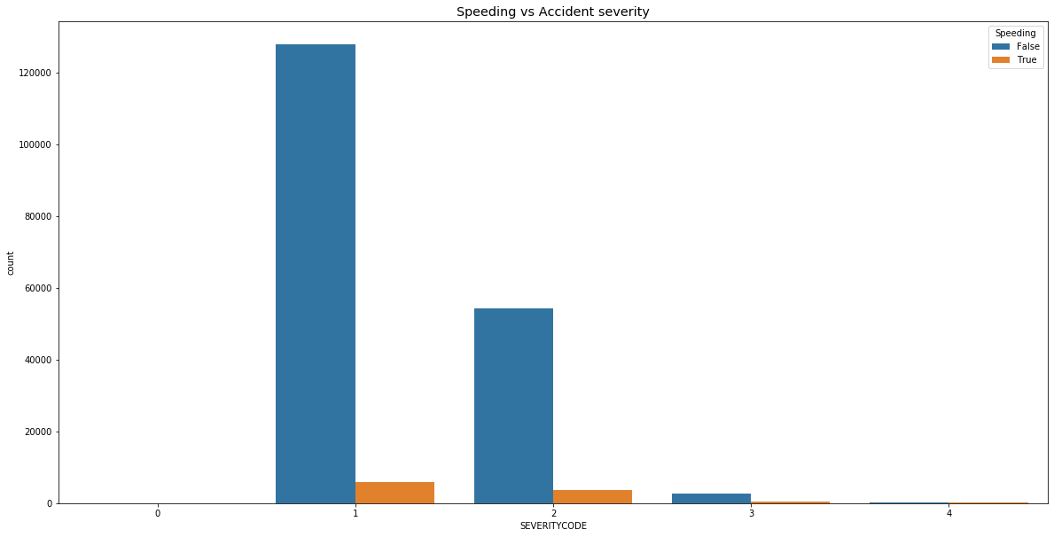
Speeding
Similar to the drug use, the probability to incur in a serious accident while speeding are almost 1%, significally higher in comparison to normal conditions (0.13%)

Slide 7
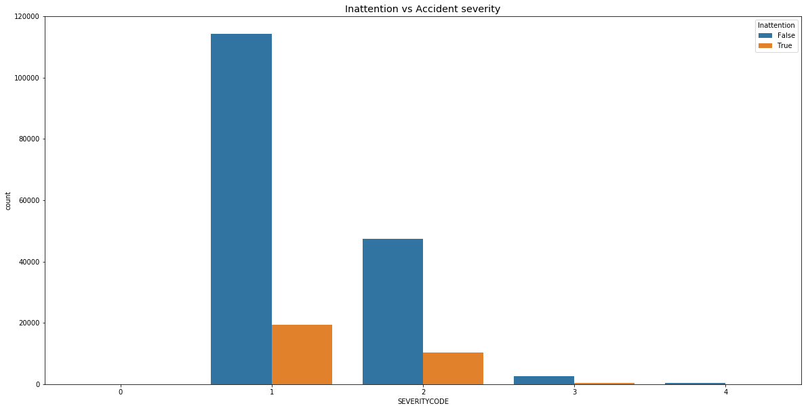
Inattention
The inattention is less impactful, since the probably to incur in a serious accidents are ~ 0.05%. Anyway, always pay attention at driving!!

Slide 8
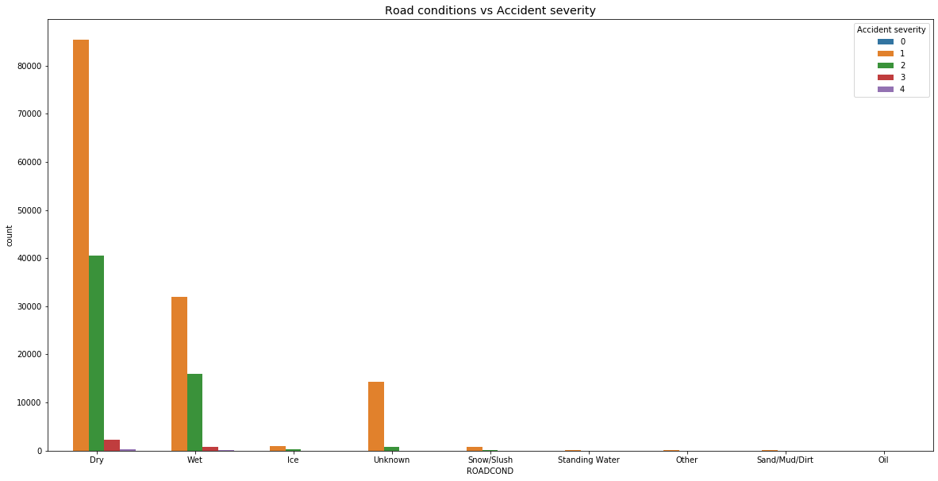
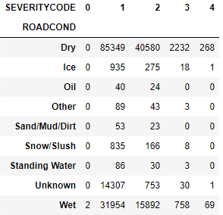
Road Conditions
The majority of the accidents were registered in a Dry condition. Anyway, the probability of a serious accident are 0.21% (dry) against 0.14% (wet)

Slide 9
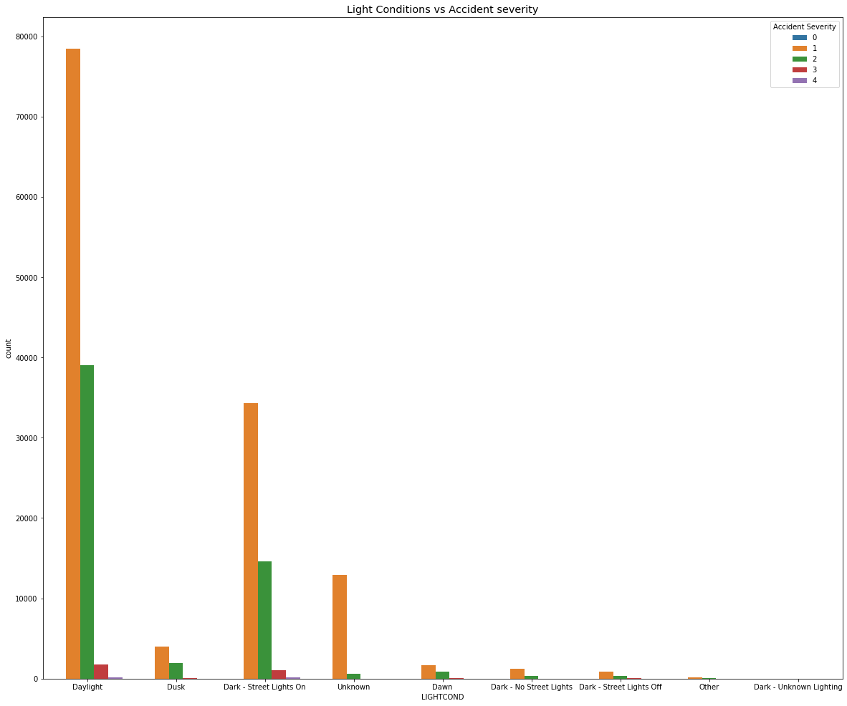
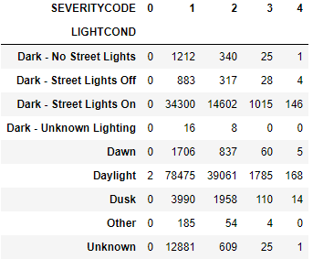
Light Conditions
To be noticed the number of accidents occurred in daily light and in dark with lights on, for severity = 3 and 4 the numbers are almost the same

Slide 10
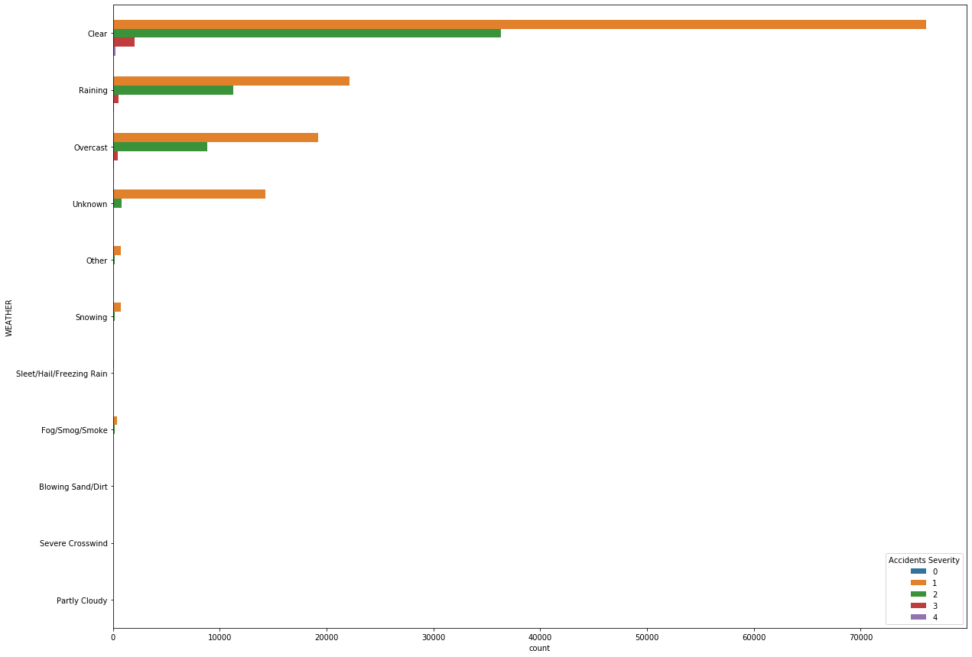
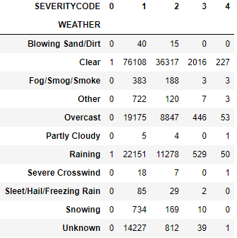
Weather Conditions
Situation is slightly different for the weather conditions
Almost the same amount of accidents were registered for both severity 3 and 4 with overcast and raining weather conditions

Slide 11
1st Analysis – Accident severity prediction using all non-dropped features
All the features were used to train the model ( in exception of those already dropped )
Random Forest Classifier and best Features for Random Forest algorithm
Decision Tree Classifier and best Features for Decision Tree algorithm
2nd Analysis – Accident severity prediction using weather, road and light conditions only
Only the weather, road and light conditions were used
Random Forest Classifier and Best Features for Random Forest algorithm
Decision Tree Classifier and Best Features for Decision Tree algorithm

Slide 12
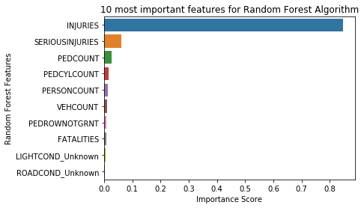
1st Analysis
Random Forest Algorithm
Really accurate algorithm. Unfortunately it is slower than the Decision Tree algorithm.
The accuracy scored was 0.9999828911
The most important feature was Injuries one

Slide 13
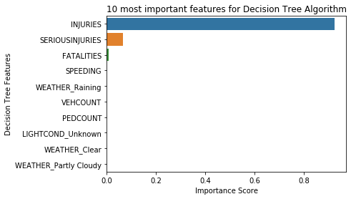
1st Analysis
Decision Tree Algorithm
Best accuracy scored: 1.0000000000
Faster than Random Forest Algorithm
Sensitive to overfitting, checked with cross_validation_score: 0.9999435494
The most important feature was Injuries one

Slide 14
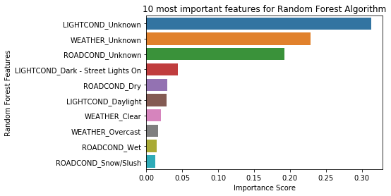
2nd Analysis
Random Forest Algorithm
Really accurate algorithm. Unfortunately it is slower than the Decision Tree algorithm.
The accuracy scored in this case was: 0.6856062550
The most important feature was the Lightcond_Unknown, followed by Weather_unknown and Lighcond_dark – Street Light On

Slide 15
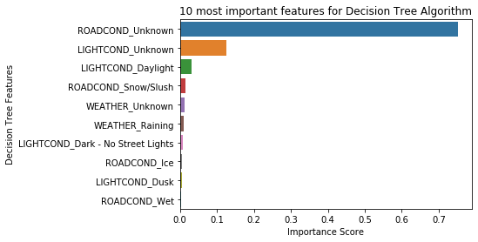
2nd Analysis
Decision Tree Algorithm
Registered again the best accuracy: 0.685857801
Faster than Random Forest Algorithm
The most important feature was Roadcon_unknown

Slide 16
Conclusions
The classifications model I chose performed almost perfectly using all the variables, so, given the number of people injured, the model could predict with and extreme precision the severity of the accident
Using only the weather, road and light conditions, the accuracy dropped significantly Despite this the model can be used anyway, giving acceptable results
Many more data are required to have better results, such as:
Forecast Weather Data of the days in which the accidents occurred
Coordinates for each accident
Coordinate of each business location and their opening hours
Density of population

